Slide 1



Object Oriented Concepts with UML
203105207
Prof. Shaleen Shukla, Assistant Professor
Information Technology Department

Slide 2
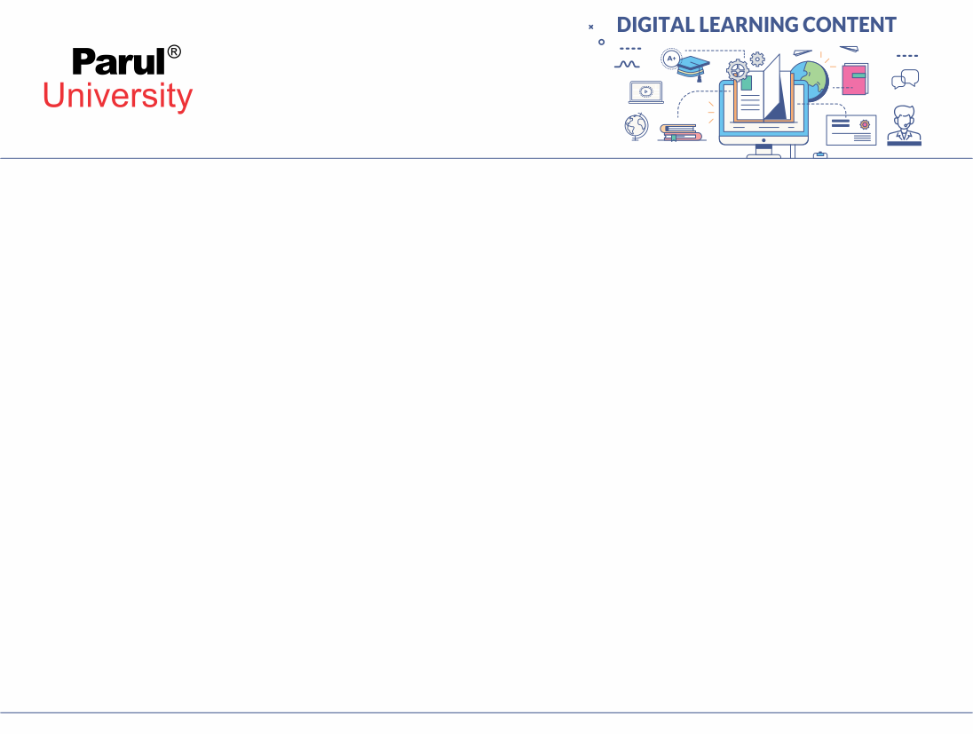

CHAPTER-1
Introduction and Modelling Concepts

Slide 3
What is Object-Orientation?
• It means that we organize software as a collection of discrete objects that incorporate both data structure and behavior
Object = Data Structure + Behavior
(attributes) (operations)

Slide 4
What is Object-Orientation?
• Five aspects of OO approach (characteristics)
- Identity
- Classification
- Inheritance
- Polymorphism
- Encapsulation

Slide 5
What is Identity?
• It means that data is quantized into discrete, distinguishable entities called objects
• Ex. White queen in chess
• Every object has its own inherent identity

Slide 6
What is Classification?
• Objects with same data structure and behavior are grouped together into a class
• Ex. Insects, mammals
• A class is an abstraction that describes a properties important to an application and ignores the rest

Slide 7
What is Inheritance?
• It’s the sharing of attributes and operations among categories supported a hierarchical relationship.
• Each subclass inherits all features of its superclass and adds its own unique features

Slide 8
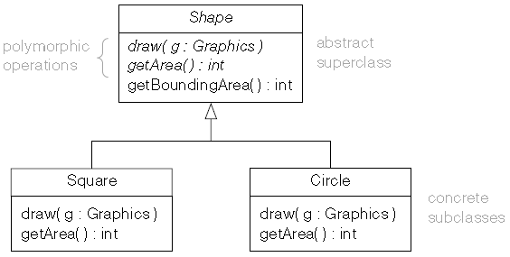
What is Polymorphism?
The same operation behave differently for different classes
Polymorphism means “many forms”. Polymorphic operations have many implementations. This is well illustrated by the Figure. polymorphism means objects of different classes have operations with the same signature but different implementations.

Slide 9
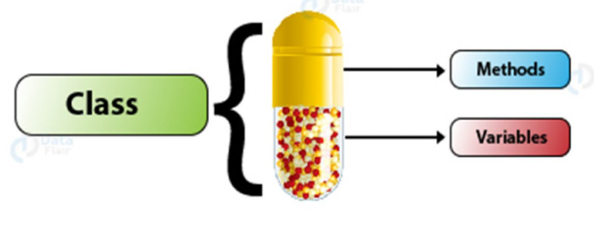
What is Encapsulation?
• Encapsulation refers to the bundling with the strategies that operate that data, or the limiting of direct access to a number of Associate in Nursing object's parts.

Slide 10
What is OO Development?
• It is a way to thinking about the software based abstraction that exists in the real world as well as in the program
• Here development refers to the software life cycle:
Analysis, design, and implementation
• It is the identification and organization of application concepts, rather than their final representation in a programming language

Slide 11
What is OO Methodology?
• Five aspects of OO approach (characteristics)
- System Conception
- Analysis
- System Design
- Class Design
- Implementation

Slide 12
What is UML?
• UML stands for Unified Modelling Language.
• It's Associate in Nursing industry-standard graphical language for specifying, visualizing, constructing, and documenting the artifacts of computer code systems.

Slide 13
UML Diagrams
- Class Diagram
- Object Diagram
- State Diagram
- Use Case Diagram
- Sequence Diagram
- Activity Diagram

Slide 14
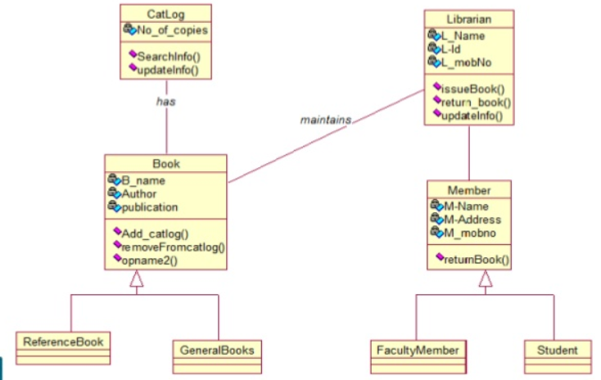
Class Diagram

Slide 15
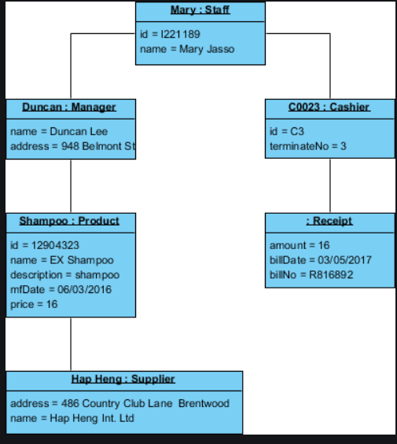
Object Diagrams

Slide 16
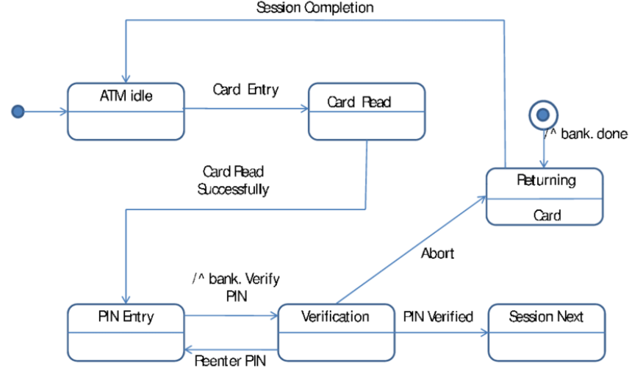
State Diagrams

Slide 17
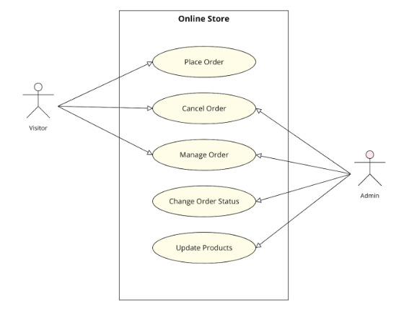
Use Case Diagrams

Slide 18
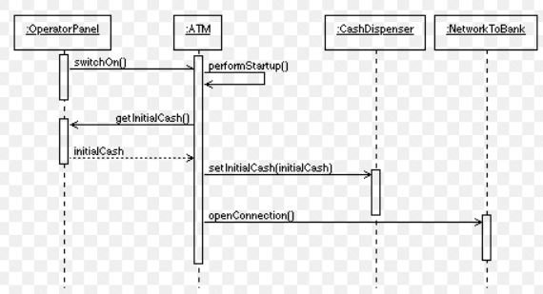
Sequence Diagrams

Slide 19
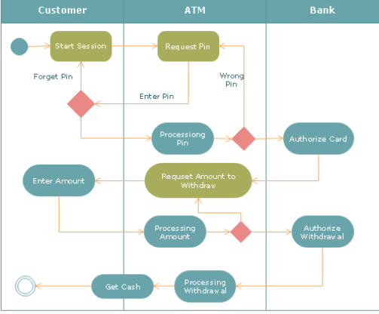
Activity Diagrams

Slide 20
Modelling
A model is Associate in Nursing abstraction of one thing for the aim of understanding it before building it.
Unified Modeling Language (UML) Models represent systems at different levels of detail.
Some models describe a system from a higher, more abstract level, while other models provide greater detail.
UML models contain model elements, such as actors, use cases, classes, and packages, and one or more diagrams that show a specific perspective of a system. A model can also contain other, more detailed models.

Slide 21
Modelling
You can use models to do the following things:
Visually represent a system that you want to build
Communicate your vision of a system to customers and colleagues
Develop and test the architecture of a system
Use the UML diagrams to direct code generation

Slide 22
Three Models of Modelling Concepts
- Class Model
- State Model
- Interaction Model

Slide 23
Class Model
Describes structure of objects in a system
Like identity, their relationships, their attributes, and their operations
Provides context for the state and interaction models
Changes and interactions are meaningless unless there is something to be changed or with which to interact

Slide 24
State Model
Describes those aspects of objects concerned with time and sequencing of operations
Events that mark changes, states that define the context for events, and the organization of events and states
The state model captures control, the aspect of a system that describes the sequences of operations that occur
But it does not take care of what they operate on, or how they are implemented

Slide 25
Interaction Model
Describes interactions between objects
Like how individual objects collaborate to achieve the behavior of the system as a whole
The interaction model describe different aspects of behavior
Use cases, Sequence diagrams and Activity diagrams document the interaction model

Slide 26
Pre Requisites
• Familiar with Analysis and Design of Class and Objects
• Be familiar with Three models

Slide 27


www.paruluniversity.ac.in

